Slide 1
How to prepare a good application form
^{Applicants seminar}
^{Nicolas} ^{Chesnel} ^{Rainer} ^{Steindler}
^{Clotilde Mahé}
Salzburg| Austria | 23-24.05.2022

Slide 2
How to prepare a good application form?
Intervention logic and outputs
Workplan and timeline of activities
Communication

Slide 3
How to prepare a good application form?
Intervention logic and outputs
Your contribution to the programme

Slide 4
Intervention logic and outputs

Slide 5
Intervention logic and outputs

Slide 6
Intervention logic and outputs

Slide 7
Intervention logic and outputs

Slide 8
Intervention logic and outputs

Slide 9
Intervention logic and outputs

Slide 10
Intervention logic and outputs
Project idea
What are our common needs and potentials?
Project objective
Project specific objectives
What do we want to change in the programme area?
What is the added value?
What are the immediate goals we can achieve within the project lifetime?
How do they contribute to the overall project objective?
How does this contribute to the programme?

Slide 11
Intervention logic and outputs
PROJECT OBJECTIVE AND SPECIFIC OBJECTIVES
Choose the right programme specific objective in your priority
Precise and explicit objective
Transnationality as key element

Slide 12
Intervention logic and outputs
Project activities
What are the necessary steps or tasks we need to implement?
Project deliverables
Project outputs
What is the outcomes of my activities?
What are the final products of the implementation of my activities?
Project results
What is the immediate foreseable change my project brings and how is it taken on board by relevant stakeholders?
How do I capture the implementation of my activities (report, study, working document)?
To which programme output indicators do they contribute?
To which programme result indicators do my results contribute?

Slide 13
Intervention logic and outputs
OUTPUTS
Three types of output indicator for your output/s:
Pilot actions developed jointly and implemented in projects
Jointly developed solutions
Other

Slide 14
Intervention logic and outputs
OUTPUTS
Three types of output indicator for your output/s:
Pilot actions developed jointly and implemented in projects
Jointly developed solutions
Other

Slide 15
Intervention logic and outputs
OUTPUTS
Three types of output indicator for your output/s:
Pilot actions developed jointly and implemented in projects
Jointly developed solutions
Other

Slide 16
Intervention logic and outputs
OUTPUTS
Three types of output indicator for your output/s:
Pilot actions developed jointly and implemented in projects
Jointly developed solutions
Other

Slide 17
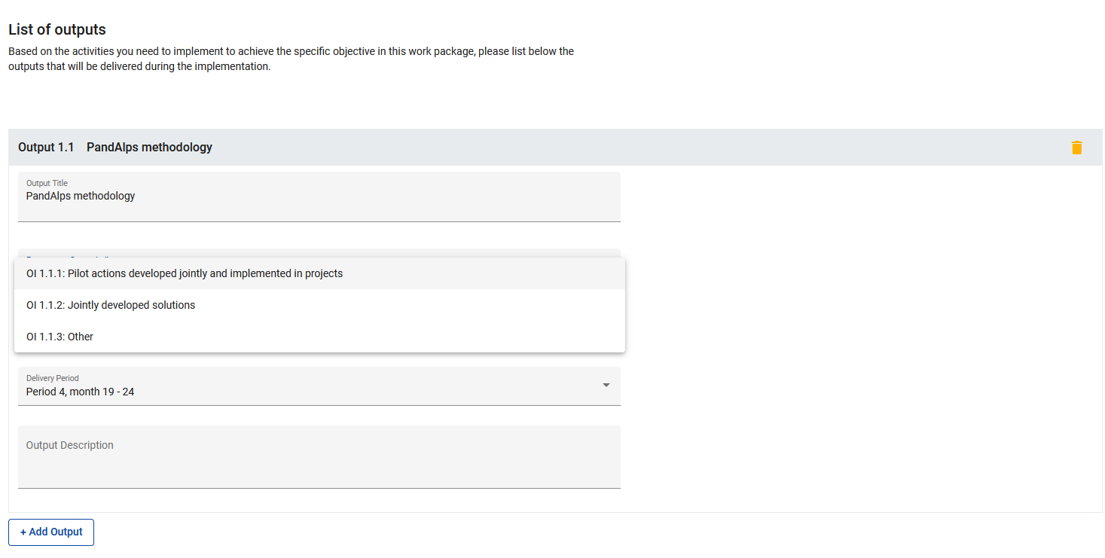
Intervention logic and outputs

Slide 18
Intervention logic and outputs
Pilot actions | Solutions | Other
→ concept/format of pilot actions concept jointly developed by the project used for implementing your pilot activities

Slide 19
Intervention logic and outputs
Pilot actions | Solutions | Other
→ concept/format of pilot actions concept jointly developed by the project used for implementing your pilot activities ⚠ target value concept ☺ each single pilot activity implemented ☹

Slide 20
Intervention logic and outputs
Pilot actions | Solutions | Other
→ concept/format of pilot actions concept jointly developed by the project used for implementing your pilot activities ⚠ target value concept ☺ each single pilot activity implemented ☹ | → implementation-oriented character practical solutions / products jointly developed by the project e.g. tool-boxes, models, instruments, action plans, concepts/methods, roadmaps, processes…

Slide 21
Intervention logic and outputs
Pilot actions | Solutions | Other
→ concept/format of pilot actions concept jointly developed by the project used for implementing your pilot activities ⚠ target value concept ☺ each single pilot activity implemented ☹ | → implementation-oriented character practical solutions / products jointly developed by the project e.g. tool-boxes, models, instruments, action plans, concepts/methods, roadmaps, processes… ⚠ no deliverable here

Slide 22
Intervention logic and outputs
Pilot actions | Solutions | Other
→ concept/format of pilot actions concept jointly developed by the project used for implementing your pilot activities ⚠ target value concept ☺ each single pilot activity implemented ☹ | → implementation-oriented character practical solutions / products jointly developed by the project e.g. tool-boxes, models, instruments, action plans, concepts/methods, roadmaps, processes… ⚠ no deliverable here | → strategic character no “pilot action” and no “solution” e.g. strategies, recommendations, policy briefs

Slide 23
Intervention logic and results
RESULTS
Two types of result indicator for your result/s:
Solutions taken up or up-scaled by organisations
Other

Slide 24
Intervention logic and results
RESULTS
Two types of result indicator for your result/s:
Solutions taken up or up-scaled by organisations
Other

Slide 25
Intervention logic and results
RESULTS
Two types of result indicator for your result/s:
Solutions taken up or up-scaled by organisations
Other

Slide 26
Intervention logic and results

Slide 27
Intervention logic and results
RESULTS
Two types of result indicator for your result/s:
Solutions taken up or upscaled by organisations
Other
→ uptake of an output by organisations ultimately leading to a change
on the ground

Slide 28
Intervention logic and results
RESULTS
Two types of result indicator for your result/s:
Solutions taken up or upscaled by organisations
Other
→ uptake of an output by organisations ultimately leading to a change
on the ground
⚠ target value
output uptaken by organisations ☺
number of organisations taking up the output ☹ (but it can be mentioned in your description ☺)

Slide 29
In a nutshell…
work package 1

Slide 30
In a nutshell…
specific objective 1
work package 1

Slide 31
In a nutshell…
activity
activity
activity
specific objective 1
work package 1

Slide 32
In a nutshell…
deliverable
deliverable
deliverable
activity
activity
activity
specific objective 1
work package 1

Slide 33
In a nutshell…
output
deliverable
deliverable
deliverable
activity
activity
activity
specific objective 1
work package 1

Slide 34
In a nutshell…
output
result
deliverable
deliverable
deliverable
activity
activity
activity
specific objective 1
work package 1

Slide 35
In a nutshell…
output
deliverable
deliverable
deliverable
activity
activity
activity
specific objective 2
work package 2

Slide 36
In a nutshell…
deliverable
deliverable
activity
activity
activity
specific objective 3
work package 3

Slide 37
In a nutshell…
WP 2
WP 1
WP 3

Slide 38
In a nutshell…
WP 2
WP 1
WP 3
overall objective

Slide 39
In a nutshell…
WP 2
WP 1
WP 3
overall objective

Slide 40
A few questions for you
→ Do you have to create the work packages Management and Communication in your AF?
A: only WP Management
B: only WP Communication
C: yes, both!
D: no, none of them!

Slide 41
A few questions for you
→ Which output indicator should you select for policy recommendations?
A: pilot actions
B: jointly developed solution
C: other
D: none of them, this is a deliverable

Slide 42
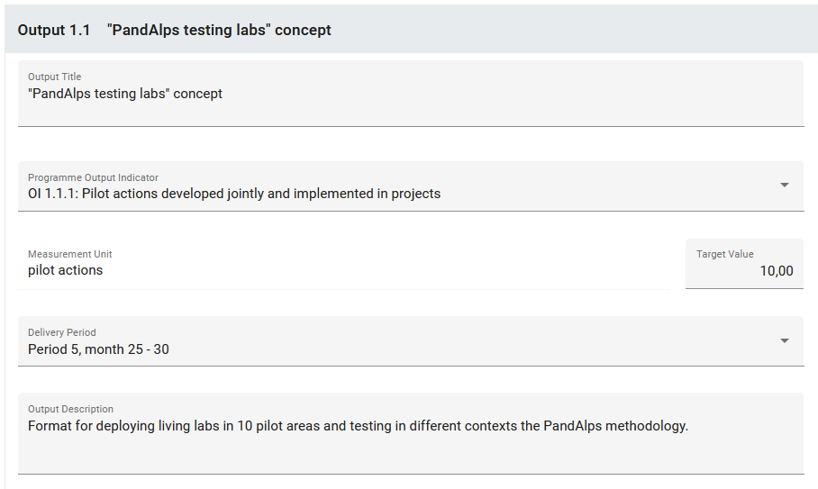
A few questions for you
→ Do you spot any mistake? A: Yes B: No

Slide 43
A few questions for you
→ Is 5 the maximum number of activities in a work package?
A: Yes
B: No

Slide 44
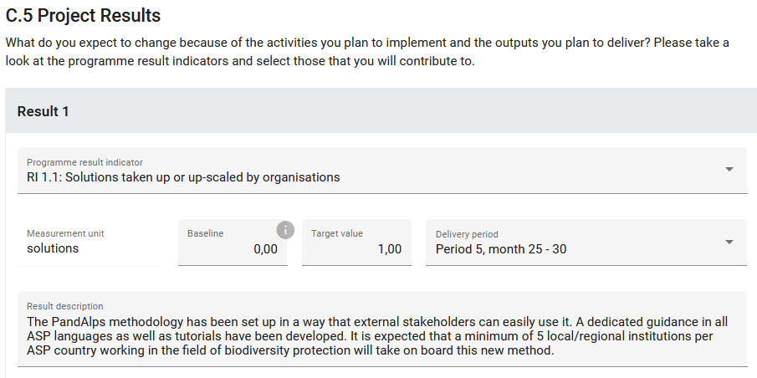
A few questions for you
→ Do you spot any mistake? A: Yes B: No

Slide 45
How to prepare a good application form?
Logical and chronological structure of your project

Slide 46
Workplan and timeline of activities
PARTNERSHIP
Experience / competence in the field addressed
Defined role and added-value of each PP
Reach-out to target groups / stakeholders
Policy role / capacity to impact on policy making
Recommendation:
→ involvement and main tasks in the activities to be clearly mentioned
→ PP budget required to be proportionate with its role

Slide 47
Workplan and timeline of activities
CONTRIBUTIONS AND SYNERGIES
Contribution to EUSALP, EU Green Deal, TA 2030, other relevant strategies
Synergies with other projects or initiatives
Recommendations:
→ get to know EUSALP action plan and actors
→ be precise and specific for the contribution you can do to strategies
→ concrete synergies reflected in the work plan
→ explain clearly your added-value to the existing

Slide 48
Workplan and timeline of activities
WORK PLAN
What is the specific objective of the work package?
How is it linked to other work packages?
Clear structure and coherence of thematic activities within the project
Recommendations (1):
→ transnational purpose = guiding principle
→ limited number of deliverables and outputs: quality vs. quantity

Slide 49
Workplan and timeline of activities
WORK PLAN
Recommendations (2):
→ a WP does not necessarily need to have an output
→ create the right output in the right WP
→ check the coherence of the timeline between WP, activities, and the delivery of outputs and deliverables
→ plan the delivery of outputs early enough (dissemination/transferability)

Slide 50
Workplan and timeline of activities
TARGET GROUPS
Relevant to the project intervention logic and to the communication approach
Concrete measures to involve them during project implementation and in the phase of output development (consulting loops etc.)
Focus on the main target groups and specify them

Slide 51
Workplan and timeline of activities
DURABILITY AND TRANSFERABILITY
Concrete measures to achieve sustainable results
Link to the target groups
Link to your communication strategy

Slide 52
Workplan and timeline of activities
DURABILITY AND TRANSFERABILITY
Concrete measures to achieve sustainable results
Link to the target groups
Link to your communication strategy
Communication

