Slide 1
National information by the
Alpine contact points (ACP)
Salzburg | Austria | 23-24 May 2022
^{Alpine Contact Points}

Slide 2
Martina bach
Austrian Spatial Planning Conference (ÖROK)
ACP for Austria

Slide 3
National information: Austria
National „Partnerformular for Austrian LP/PP will be sent to AT LP/PP via E-Mail. Deadline for submission: 7. July 2022
National control system Austria decentralized
Control only by nominated controllers (predefined list)
The control costs have to be borne by the Austrian beneficiaries > plan adequate budget for control in CC External experts
Further Info https://www.oerok.gv.at/kooperationen/info-service-oesterreich-ncp/finanzkontrollsystem-in-oesterreich
Questions? ACP AT - Martina Bach, phone: +43 1 535 34 44 22, e-mail: bach@oerok.gv.at

Slide 4
Sébastien rieben
Federal Office for Spatial Development (ARE)
Switzerland

Slide 5
National information: Switzerland
No national requirements
Questions? ACP CH – Sébastien Rieben phone: +41 (58) 462 40 78, e-mail: sebastien.rieben@are.admin.ch

Slide 6
Lisa horn
Bavarian State Ministry for the Environment and Consumer Protection
ACP for Germany

Slide 7
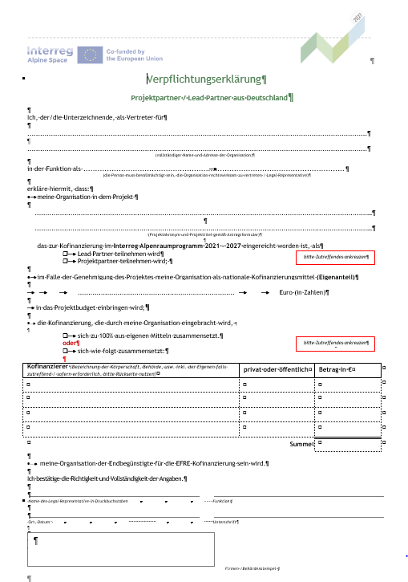
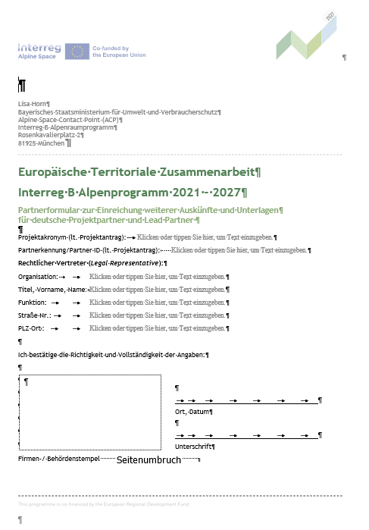
National Requirements: Germany
Two documents with signature by the legal representative:
„Verpflichtungserklärung“ & „Partnerformular“
Notes:
Why: To verify the legal status public/private
To verify the legal representative
To verify other financing within the framework of project preparation
For financial security

Slide 8
National Requirements: Germany
Who:
ALL German Project Partners (LP and PP)
What:
2 National documents
-> „Verpflichtungserklärung“
-> „Partnerformular“
When:
Due at the submission date of the full application in the second step (Call 1: 4th July 2022) (Small Scale Projects: due with cut-off-date)
How:
To be sent to the ACP Germany by postal service (post mark)!
All information & adress on our website:
www.alpine-space.eu/for-applicants/national-information ->DE

Slide 9
Chloé ribaudeau
Auvergne-Rhône-Alpes Regional Council
ACP for France

Slide 10
National Information - France
National requirements for french LPs and PPs
Document to be sent by email to the National contact point and national coordinator (interreg.espacealpin@auvergnerhonealpes.fr)
Template available on the website : https://www.alpine-space.eu/wp-content/uploads/2022/02/National-Requirements-21-27.docx
FLC costs to be foreseen in the budget of each LP / PP
Around 4000€ for the project (6 project reports)
LPs / PPs have to plan sufficient budget for the FLC > external expertise
The national authority will pre-select a shortlist of 4 FLCs
Each LP / PP will select its FLC among the shorlist

Slide 11
National Information - France
Contacts
Chloé Ribaudeau, ACP France
interreg.espacealpin@auvergnerhonealpes.fr – 0426734398
Sara Poupart, National coordinator
sara.poupart@auvergnerhonealpes.fr – 0426734596
Noémie Southammavong, First level control coodinator
noemie.southammavong@auvergnerhonealpes.fr

Slide 12
roberto de marco
Lombardy Region
ACP for Italy

Slide 13
National Requirements for italian PPs
not yet officially approved, so those of the previous period (2014-20) have been extended to the 1st Call
documents to be sent to the ACP, to be delivered after the deadline
The ACP will send via email the form to be filled
differentiated on the two steps
no longer mandatory to consult the ACP (but it is recommended)

Slide 14
First Step
Documents to be provided:
Lead Partner:
Autocertificazione forma giuridica
Autocertificazione del responsabile legale
Curriculum Vitae dell‘ente
Other Partners:
Curriculum Vitae dell‘ente

Slide 15
Second Step
Documents to be provided:
Curriculum Vitae:
Only for PP/LP who were not part of the AF-step1
Autocertificazione forma giuridica:
For all the project partners
For the LP if it is different from AF-step1
Autocertificazione del responsabile legale
For all the project partners
For the LP only if it is changed compared to AF-step1

Slide 16
Point of attention
All declaration, to be valid, must be accompanied by a copy of the identity document of the legal responsable signing the declaration
Not necessary in case of digital signature

Slide 17
Share of national co-financing
In case the project will be financed:
The national co-financing share is 25% (FONDO DI ROTAZIONE)
It can be requested both by public or private organisations (NEW!)
The request can be sent only after the CE has paid the ERDF to the LP and the LP has shared it to the PPs
The competent body is the Agenzia per la Coesione

Slide 18
First Level Controller
Each PP must choose his own first level controller
The choice is up to each beneficiary individually
The PP can do it by:
Using a certified list (random combine)
Making a public procurement
Choosing an internal FLC (only for public body)
Controller must have proved experience and qualification

Slide 19
Danijela kos
Government office for development and cohesion policy
ACP for Slovenia

Slide 20
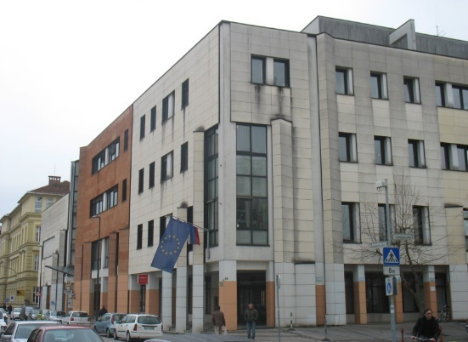
INFO FOR PARTNERS
Government Office of Republic Slovenia for Development and European Cohesion Policy
European Territorial Cooperation and Financial Mechanism Division
European Territorial Cooperation and Financial Mechanisms Section
Kotnikova 5
SI - 1000 Ljubljana
Regional office Štanjel
Phone: 00386 5 7318530
Email: danijela.kos@gov.si

Slide 21
NATIONAL REQUIREMENTS - SLOVENIA
CLASSIC PROJECTS – CALL 1 – no special national requirements in step 1 and step 2
In the time of step 2 – ACP check of LP/PP legal status
ACP financial capacity check (request for additional documents)
Additional questionnaire will be sent to the LP/PP
Contacting PP/LP if neccessary

Slide 22
THANK YOU!

