Slide 1
“What you do makes a difference, and you have to decide what kind of difference you want to make.”
Dr Jane Goodall, Scientist & Activist

Slide 2
WARM-UP
What does the term 'sustainable' mean?
a) The implementation of eco-friendly technologies.
b) A balance between meeting today's needs with those of the future.
c) The use of alternative energies.
b) Paragraph 27 of the report entitled 'Our Common Future' issued by the World Commission on Environment and Development states that Humanity has the ability to make development sustainable to ensure that it meets the needs of the present without compromising the ability of future generations to meet their own needs. The concept of sustainable development does imply limits - not absolute limits but limitations imposed by the present state of technology and social organization on environmental resources and by the ability of the biosphere to absorb the effects of human activities.

Slide 3
WARM-UP
2. German households produce on average half of the world's waste generation per capita.
True or False?
True. Germany’s recycling program is one of the most successful in the world due to its household involvement.

Slide 4
WARM-UP
3. Which is worse for the environment, the average numbers of emails a person receives in a year or the average Km a person will drive in a car per week?
Email
Car
a) Email

Slide 5
Project management & sustainability
^{Salzburg| Austria |}
^{Jana Habjan}
^{24.05.2022}

Slide 6
Overview
Background information
PROJECT MANAGEMENT:
Structure
Process
Tools
SUSTAINABILITY
Project greening
Promoting the project´s environmental achievements
Notes:
The purpose of this presentation is to provide support in structuring projects, mostly in terms of project management structure, processes and tools.

Slide 7
Project management
Structure│Process │Tools

Slide 8
Background information
Programme requirements vs. Project management
LP responsibility (Subsidy Contract, Article 6)
2014-2020: Fact sheet 4.9. on Project management

Slide 9
Project management: STRUCTURE
Notes:
A well-functioning project management structure is essential for the success of the project. Thus sufficient resources should be alocated for the different project stages, from start to closure.
The organisational structure within an AS project foresees the following bodies:
1) PSG as decision-making body as established in article 6 of the partnership agreement;
2) Project Management Team at the LP organisation consisting of a project manager, a finance manager and a communication manager who altogether will ensure the operative management of the project;
3) WP Leader who willl be responsible for taking over the coordination of the WP tasks and activities.

Slide 10
Project management: PROCESS
Notes:
Drafting of the AF. in which projects are encouraged to make use of project management tools.
Preparation, organisation and implementation of the Kick-off meeting, fine-tuning of the planning.

Slide 11
Project start process

Slide 12
Project management: PROCESS
Project management
Notes:
Qualitty control (i.e. monitor progress and review it, if needed).

Slide 13
Project management: PROCESS
Project management
Notes:
Wrap-up of project activities, payments, drafting of the last and final report, definition of tasks and responsibilities after project closure.

Slide 14
Project management: PROCESS
Project management
Notes:
Administrative closure of the project (submission of the last and final report, follow-up actions at programme level, e.g. audits).

Slide 15
Project management: TOOLS
No WP on Management & Communication BUT clear description in AF Step 2/ C.7 PM
AF, JEMS ≠ PM Tools
Operational management → Gantt Chart, Work Breakdown Structure, Stakeholder analysis, etc.

Slide 16
sustainability
Project greening│Promotion

Slide 17
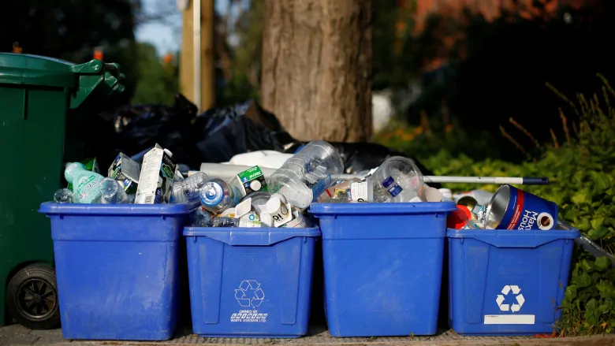
Why project greening?
Horizontal principle
NEUTRAL or POSITIVE on sustainable development
What about the daily project implementation?

Slide 18
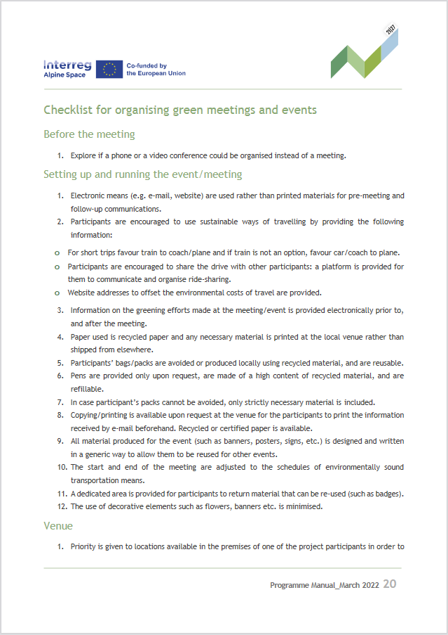
Project greening
Eco-friendly practices, especially for events and meetings.
Energy efficient and sustainable principles:
Project publications and promotional products
Events and meetings
Office daily activities.

Slide 19
Promoting the project ́s environmental achievements
Sustainable practices of your daily work
#EUGreenDeal
Encourage and inspire

Slide 20
More on Project management & Sustainability…
Programme manual chapter A.4
Greening at national/regional level (look what already exsist in your administration)
UNEP Guide to Climate neutrality: „Kick the habit“
UNEP: Green meeting guide for participants
European green office
EU: 2050 long-term strategy

