Slide 1
Legal issues
^{Salzburg| Austria | 24.5.2022}
^{Christina Bauer}

Slide 2
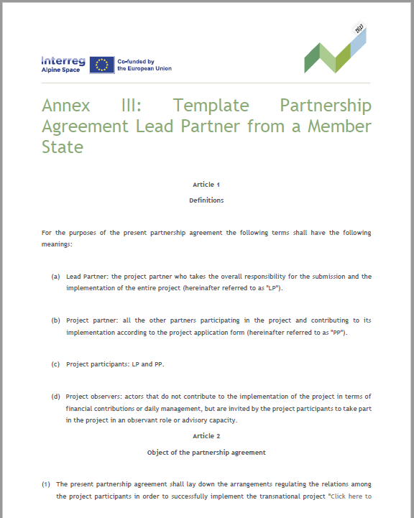
Partnership agreement (PA)
foreseen by EU regulations (article 26 of Interreg-regulation (EU) No. 2021/1059)
regulates relationship between LP and partners for project implementation
  templates to be used provided by programme
  based on >20 years experience in transnational cooperation
  minimum clauses of templates may not be changed, but additional rules can be foreseen
to be uploaded in JEMS as attachment of the application form

Slide 3

PA – Procedure
Option 1
(minimum clauses)
Option 2
(additional clauses)
Just add project name, working language, number of copies, applicable law, place of jurisdiction
LP sends draft of additional clauses to MA for check as soon as possible, at latest by 24.06.2022
alpine.space@salzburg.gv.at
Today's seminar: guidance
signature: (ERDF) LP with each PP
signature: (ERDF) LP with each PP
submission with AF in JEMS
submission with AF in JEMS
4 July 2022

Slide 4
PA – procedure
upload partnership agreement with all signature pages in JEMS
if difficulties faced with signature, please inform MA before the deadline for the submission of the application package and upload a letter in JEMS justifying the delay
number of copies: LP and each PP shall receive one original
make sure to indicate date of signature and hint on authorisation for signature in case different person than named in the AF signs PA
two options to sign: bilateral or multilateral agreement
several PA bilaterally signed (trilaterally if ERDF-LP)
one PA with all signatures

Slide 5
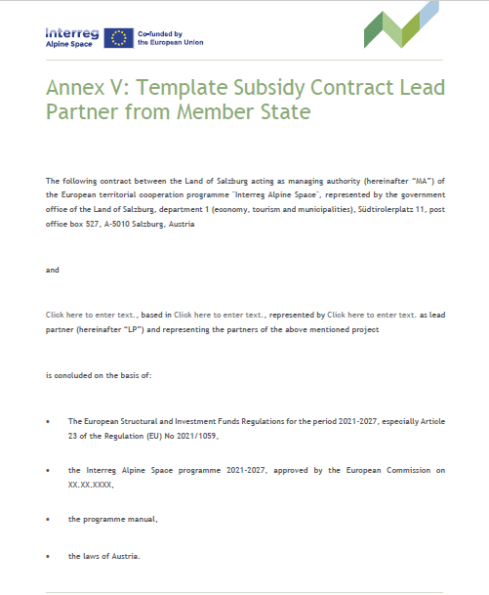
Subsidy contract (SC)
foreseen by EU regulations (article 26 of Interreg-regulation (EU) No. 2021/1059)
regulates conditions for ERDF-grant, tasks, duties and responsibilities of LP
2 templates: LP from MS, LP from non-MS
  in partnership agreement all partners declare to have read the provisions of the subsidy contract (SC)
  valid throughout project lifetime

Slide 6
SC - Procedure
Oct 2022
Project approval by programme
MA/JS inform about approval and sends subsidy contract via e-mail
Signature by LP (& ERDF-LP)
and send back to MA
or handover to MA at LP seminar
Nov 2022
MA countersigns contract as soon as JS confirms that all deficiencies in AF have been corrected by LP

Slide 7
State Aid

Slide 8
State aid criteria – Article 107(1) TFEU
transfer of state resources
  national, regional, public funds, also EU-funds if managed by a member state
selectivity
  not all companies in a country, but only selected ones
effects on competition and trade
  Potential effect is already enough, sufficient if an entity acts on the market and there is trade among member states, not given in cases like sports infrastructure, cultural events, health services aiming at local audience
economic advantage
  grant, loan with interest rate rebates, liabilities, capital injections
undertaking
  any entity engaged in an economic activity (offering goods and services on the market for pecuniary interest), regardless the legal form, the way of financing, profit-orientation
  NO state aid if only one of criterion is not fulfilled
8

Slide 9
Self-check
  Is any of your project partners an undertaking?
Does it offer goods or services on a market?
What counts is the type of activities, not the legal status
of your partners (they may be public or private, profit or no-profit)
Are the project activities happening on the market?
  Does any of your project partners receive an economic advantage?
would benefits have arisen in normal market conditions?
does it keep this advantage or does it pass it on to other players, eg. by offering trainings for free for companies or by spreading project results

Slide 10

Direct and indirect State Aid
Programme funds project participant (PP)
PP passes advantage on to third party, eg. by providing workshop for SME free of costs
No state aid on level of PP, but potential state aid on level of target group (SME)
Programme
Project partner
Target group
10

Slide 11
State Aid Approach of the Programme
All state aid criteria fulfilled?
not state aid relevant
NO
YES
reshaping of project possible to avoid state aid?
Ask LP to rework project
YES
NO
GBER applicable and preferred by PP?
Monitoring & reporting by MA
YES
NO
Ask PP for de-minimis declaration, check limits in case of Austrian PP, monitoring & reporting by MA
De minimis aid possible?
State aid check done by JS with support MA, documented in JEMS, PC decisions, CB controls if state aid rules are obeyed, JS verifies if project activities carried out as set out in AF and requested by PC
11

Slide 12
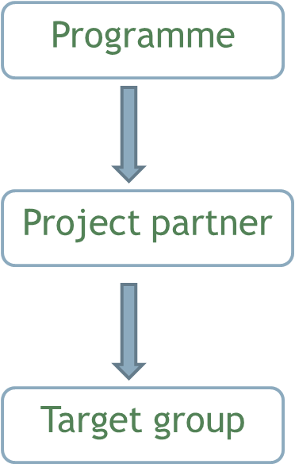
GBER Articles 20 and 20a on ETC-projects
Article 20: aid for costs of undertakings as partners in ETC-projects allowed if
staff costs, costs for office and administration, travel & accommodation costs, external expertise and service costs, equipment costs, infrastructure costs and
aid intensity not higher than co-funding rate foreseen in regulation/programme (75%)
Article 20a: aid for costs of undertakings as target groups of ETC-projects fine if
total amount granted to undertaking per project is not more than 20.000 €
PP shall define value of advantage for end-users (target groups) in AF
e.g. one workshop for 20 companies costs 25.000 Euro.
MA/JS check and PC approve.
CB only needs to verify if amount is below value of art. 20a GBER
(max. 20.000 Euro per undertaking taking part in the measure/event).
12

Slide 13
De minimis
in case of project approval under de minimis:
self-declaration to be submitted by respective project participant to MA before signature of subsidy contract
limits of de minimis aid:
  max EUR 200,000 (gross grant equivalent)
  or EUR 100,000 for road freight transport sector
  over a 3 year period
  per single undertaking
  per Member State
  aid provided by MS of MA: Austria

Slide 14
Where to learn more?
Programme implementation handbook
INTERACT questions and answers: https://www.interact-eu.net/library/qa-state-aid/pageflip
Articles 107-109 of the TFEU
Commission notice on notion of state aid: http://eur-lex.europa.eu/legal-content/EN/TXT/PDF/?uri=CELEX:52016XC0719(05)&from=EN
DG Competition website: http://ec.europa.eu/competition/state_aid/overview/index_en.html

Slide 15
Procurement law

Slide 16
Who has to apply procurement law?
state, regional or local authorities or
bodies governed by public law, i.e. bodies that
  are established for the specific purpose of meeting needs of general interest, not having an industrial or commercial character AND
  have legal personality AND
  are financed, for the most part (>50%), by the state, regional or local authorities, or by other bodies governed by public law OR are subject to management supervision by those authorities or bodies OR have an administrative, managerial or supervisory board, more than half of whose members are appointed by the state, regional or local authorities, or by other bodies governed by public law.
16

Slide 17
EU-Thresholds
EU law sets harmonised rules for tenders whose monetary value exceeds a certain amount and which are presumed to be of cross-border interest
The European rules ensure that the award of such contracts is fair, equitable, transparent and non-discriminatory
For tenders of lower value national rules apply, which nevertheless have to respect general principles of EU law.
The current EU-thresholds as of 1.1.2022 are:
Nature of procurement | Type of contractor | Estimated value, excluding VAT
Public contracts for services and supply | Central Government authorities (e.g. ministries) | EUR 140,000
 | Sub-central contracting authorities (e.g. regions, municipalities) | EUR 215,000
Public contracts for works | Both central and sub-central authorities | EUR 5,382,000

Slide 18
Funded procurement and its control
Source: European Court of Auditors, special report 2015/10, p. 14
18

Slide 19
Procurement rules of the programme
Public body according to procurement law | Private project partners not subject to procurement law
national procurement law | < 10.000 net value | According to the programme´s eligibility rules the principles of efficiency, effectiveness and economy have to be observed. Consequently, compliance with these principles has to be proved. This can be done by e.g. providing empirical values, an internet price comparison or comparison with data from previous purchases.
regional procurement law | > 10.000 net value | Proof of adequate market search (e.g. by collecting offers from at least two different market operators)
internal rules of PP | Proper documentation of procurement to be ensured
even if direct award allowed PP shall provide evidence of market research to ensure economic use of funds
19

Slide 20
Procurement and Simplified Costs
If costs for external expertise and services and equipment are co-financed on a real cost basis, controllers will carefully check the procurement procedure.
Any mistake detected might lead to
a reduced amount that will be reimbursed and to
a reduction of reimbursement of project costs that are calculated as a flat rate on costs for external expertise and services
If 40% flat rate for eligible costs other than direct staff costs is applied, beneficiaries will not have to document and prove their procurement procedures against programme bodies, controllers or auditors.
20
20

Slide 21
Strategic use of Public Procurement
Procurement procedures can be used to foster green economy, innovative solutions, social aspects, SME as contractors.
This can be done by:
taking these aspects into account in the planning of the procurement and the specification of services (e.g. a study on a certain topic shall take into account the different needs of men and women),
setting specific selection and award criteria (e.g. preference given to equipment with low electric power consumption),
including specific clauses in the contract with the provider of the service, good or work (e.g. foresee that certain tasks are performed through the involvement of disabled persons and establishing a contract penalty in case this is not respected)
21
21

Slide 22
Project Partners vs. External Experts
Project participants may not contract each other to carry out project activities
An organisation cannot become project partner if the main activity within its business profile and role in the project consists of project coordination, management, communication, consulting or other activities that are of a mere executive or supporting character. Such activities are usually provided by external service providers.
The JS will check the fulfilment of this requirement during the quality assessment phase
It is recommended to get in touch with the national ACP beforehand.
22

Slide 23
Joint cross-border procurement
Procurement law allows for joint procurement of contracting authorities of different member states, if they agree on:
responsibilities of partners and applicable law
internal organisation of procurement incl. management of procurement and distribution of procured services, supplies, works (article 39 of directive 2014/24/EU)
Project partner acts in line with procurement when it purchases elements from partner acting as contracting authority and being responsible for procurement
40% flat rate recommended for all PP making use of joint procurement.
Only PP using real-cost option may carry out joint procurement.
Cost calculation options to be defined in AF already.
23

