Slide 1
Communication training: social media and storytelling
Participants workspace

Slide 2
What you will leave with today
By the end of this session you will have:
A communication persona for a real project output
A storyboard built on that output
A draft post ready to publish — compliant with Alpine Space requirements
Three reusable checklists to apply to every future post.

Slide 3
Knowing your audience
Block 1

Slide 4

The „communication persona“
A realistic portrait of one person in your audience.
Not a demographic. A human being.
Name
Age and where they live
What they care about
One problem they have that your output relates to
What platform they are on and when
The persona is your anchor.
When a sentence feels wrong, ask: would this person understand it? Would they care?

Slide 5
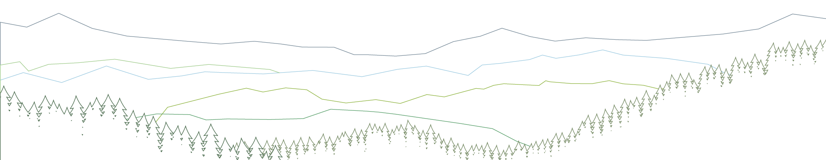
Build your communication persona
Exercise
Open your slide deck. Go to the persona slide.
Who is one real person in your audience for this output?
Give them:
A name and an age
A specific place
One problem they have that your output relates to
The platform they are on
What would make them stop scrolling
If you can, base it on a real person you have met or can picture clearly.

Slide 6
Build your communication persona
Exercise
YOUTH4ALPS example
Name: Lucas
Age: 22
Where: Haute-Savoie, rural France
Platform: Instagram
One problem:
Can't find structured green sector training without leaving home.
What makes him stop scrolling:
Something that speaks to where he lives — not written for a conference room.
Why he would care about this output:
50 apprenticeship places, four countries, applications open now.
Your persona
Name:
Age:
Where:
Platform:
One problem:
What makes them stop scrolling:
Why he would care about this:

Slide 7
FROM OUTPUT TO STORY
Block 2

Slide 8

The storyboard structure
1. Context
The world your persona lives in. Set the scene briefly.
2. Specific problem
The challenge they face that your project relates to.
3. Idea
What your project set out to do about that problem.
4. Solution
What concretely happened: your output, your deliverable, your activity.
5. Proof
Numbers, facts, evidence. Make it tangible.
6. Vision / impact
What changes for your persona in one sentence.

Slide 9
Writing in plain language — 9 guidelines
1. Put the reader first: write for what they need, not what you want to say
2. Put important information first
3. Keep it short: less is more
4. Write for one specific person, not a general audience
5. Use active voice: people doing things, not things being done
6. Be personal: use "you" and "we"
7. Be consistent: use the same words for the same things
Use positive phrasing: say what is, not what is not
Read your text aloud before publishing: you will hear what does not work

Slide 10
YOUTH4ALPS example – Storyboard for Lucas
1. Context
Young people in Alpine rural areas have limited access to structured training in green sectors.
2. Specific problem
Without cross-border pathways, talented young people must choose between their region and their career.
3. Idea
YOUTH4ALPS created a platform matching young people in Alpine rural areas with green apprenticeships across four countries.
4. Solution
Partners sourced 50 apprenticeship places, built the matching platform, and opened applications in April 2026.
5. Proof
50 places. France, Italy, Austria, Switzerland. Applications open now.
6. Vision / impact
Lucas can start a career in environmental work without leaving Haute-Savoie.

Slide 11
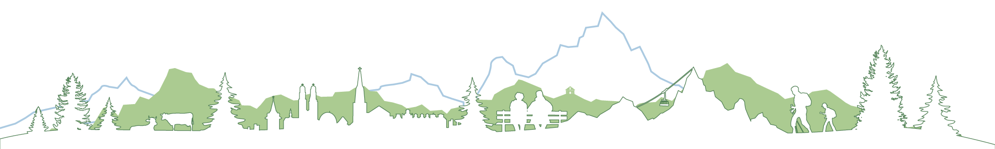
Build your storyboard
Exercise
Open your slide deck. Go to the storyboard slide.
Complete steps 1 to 4 for your own output:
1. Context — the world your persona lives in
2. Specific problem — the challenge they face
3. Idea — what your project set out to do
4. Solution — what concretely happened
One sentence per step. Write for your persona.

Slide 12
Build your storyboard
Exercise
Your storyboard:
1. Context
The world your persona lives in. One sentence .
2. Specific problem
The challenge they face. One sentence.
3. Idea
What your project set out to do. One sentence.
4. Solution
What concretely happened — your output. One sentence.

Slide 13
Making your post work
Block 3

Slide 14
From storyboard to post: 3 layers
Hook
The first line. Earns the next line. Must work before the caption collapses or the 'see more' cut-off. If this line fails, nothing else matters.
Body
Your story. Steps 1–4 from the storyboard, compressed. Short paragraphs. White space. Human voice.
Call to action
One specific action. Not 'find out more.' Apply, register, download, attend. On Instagram: link in bio.
Proof and vision go at the end of the body or in the hook: they anchor the story in reality.

Slide 15
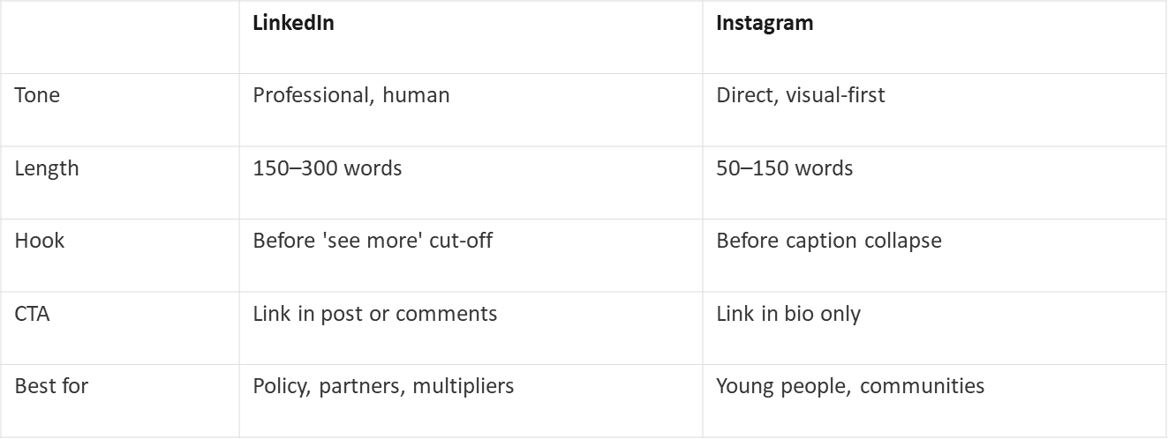
LinkedIn vs Instagram

Slide 16

Accessibility essentials
Alt text
Describe what the image shows in one sentence. Not 'YOUTH4ALPS photo' — 'Four young people in work gear planting trees on an Alpine hillside.' Be specific.
Captions and subtitles
Add subtitles to all video content. Assume some viewers have sound off — on LinkedIn and Instagram, autoplay is silent.
Descriptive links
Write 'Apply for an apprenticeship' not 'Click here.' The link text should tell you where you are going before you click.
Hashtags
Capitalise each word: #GreenJobs not #greenjobs. Screen readers read #greenjobs as one word. #GreenJobs reads as two. Use common hashtags.

Slide 17
Compliance to rules
1. Programme branding
Tag the programme in the post text and #Interreg
2. State the funding in the post text
The caption should explicitly state that the project is co-funded by the Interreg Alpine Space programme (not just in the logo).
Use: "Co-funded by the Interreg Alpine Space programme"
3. Follow the EU emblem rules on visuals
The EU emblem must appear on any visual published.
Minimum size, no distortion, correct version for the background.
Use only the digital files provided, don’t recreate.

Slide 18
YOUTH4ALPS — same story, two platforms
LinkedIn
You don't have to leave the Alps to build a green career.
Finding structured environmental training in rural Alpine areas is hard. Most opportunities are in cities. Most young people end up choosing between their field and their region.
Today, YOUTH4ALPS opens applications for 50 cross-border green apprenticeships across France, Italy, Austria and Switzerland.
If you work with youth organisations or rural communities in the Alpine Space: share this.
Applications open until 8 June.
Co-funded by the Interreg Alpine Space programme @interregalpinespace #Interreg #GreenJobs
Instagram
You don't have to leave the Alps to build a green career.
50 cross-border green apprenticeships. France, Italy, Austria, Switzerland.
Applications are open until June 8 — this is for you if you're young, rural, and looking for a real start in environmental work.
Link in bio to apply.
Co-funded by the Interreg Alpine Space programme @interregalpinespace #Interreg #GreenJobs #GreenApprenticeship
Notes:
Same storyboard. Same six steps. Two completely different posts. On LinkedIn: I'm writing for a multiplier audience — youth organisations, employment services, local NGOs who can reach Lucas. The CTA is 'share this,' not 'apply.' The tension is named explicitly. I have room to develop it. On Instagram: Lucas might actually be here. Three short blocks. Hook, numbers and who it's for, link in bio. Nothing more. He scrolls fast.

Slide 19
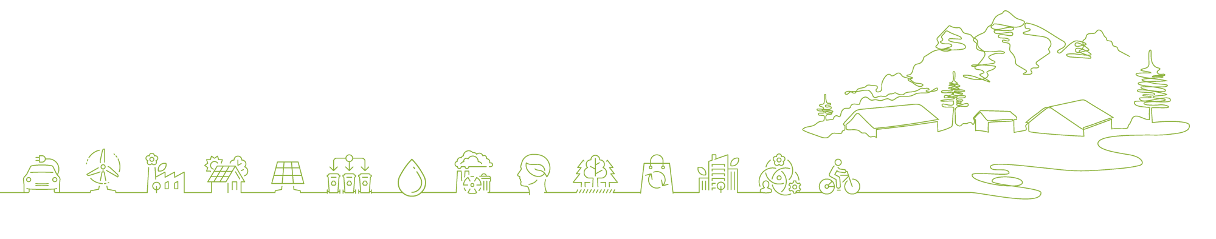
Write your draft post
Exercise
Open your slide deck. Go to the draft post slide.
First: confirm your platform.
LinkedIn — for partners, multipliers, policy audiences
Instagram — for direct audiences, communities, young people
Then write:
Hook — first line that earns the next
Body — story from your storyboard, compressed
Call to action — one specific action
Compliance line — tag + funding statement
Apply the plain language guidelines.
Apply your platform's length.

Slide 20
Write your draft post
Exercise
Your draft post:
Platform
Post text
Compliance line: Co-funded by the Interreg Alpine Space programme @interregalpinespace #AlpineSpace
Hook
Body
Call to action
Compliance line
LinkedIn / Instagram / Facebook

Slide 21
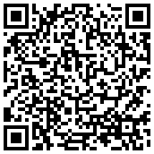
Publish your post this week!
Please fill in the feedback form — scan the QR code or click the link in chat.
Thank you!

